Slide 1
Budget Users’ Group Refresher on Basic Budget Office Roles, Processes & Goals
September 26, 2018

Slide 2
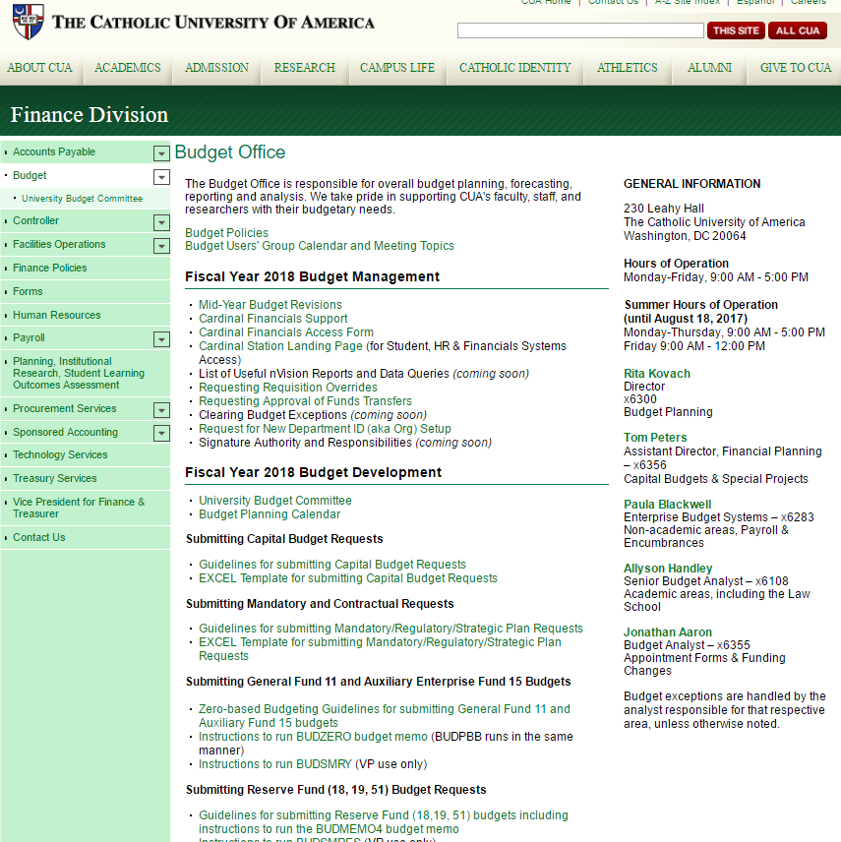
http://treasurer.cua.edu/Budget-Office/budgetoffice.cfm
Website Redesign in Progress
On-Demand FAQs/Help
Important Policies and Informational Materials
Contact Info*
Quick Links for Basic Processes/ “How To’s”
Will Be Updated with FY20 Instructions as Available

Slide 3
Initial Points of Contact
Academic Unit
Academic Budget Office
Academic Budget Office
University Budget Office
Cognizant Finance Department
Budget Issue
Actuals Issue
Non-Academic Unit

Slide 4
Roles: What the CUA Budget Office Does
Review & approve new org or financial aid itemtype requests
Review & approve new faculty, staff & student position requests (iCIMS)
Review & approve capital project requests against plan
Set up new fund/account/org combinations for payroll transactions
Change department affiliations for positions on the budget side (there is a separate process on the HR side that needs to also be done by them)
Track fiscal year budgets for individual full-time, regular positions
Create salary sheets for the merit award process
Create short (fiscal year) & long (3-5 year) range financial forecasts used by Senior Management to compile future budgets
Run monthly/quarterly budget to actuals reports
Reconcile & upload original budgets and mid-year revisions
Maintain financial reporting tree structure & nVision layouts

Slide 5
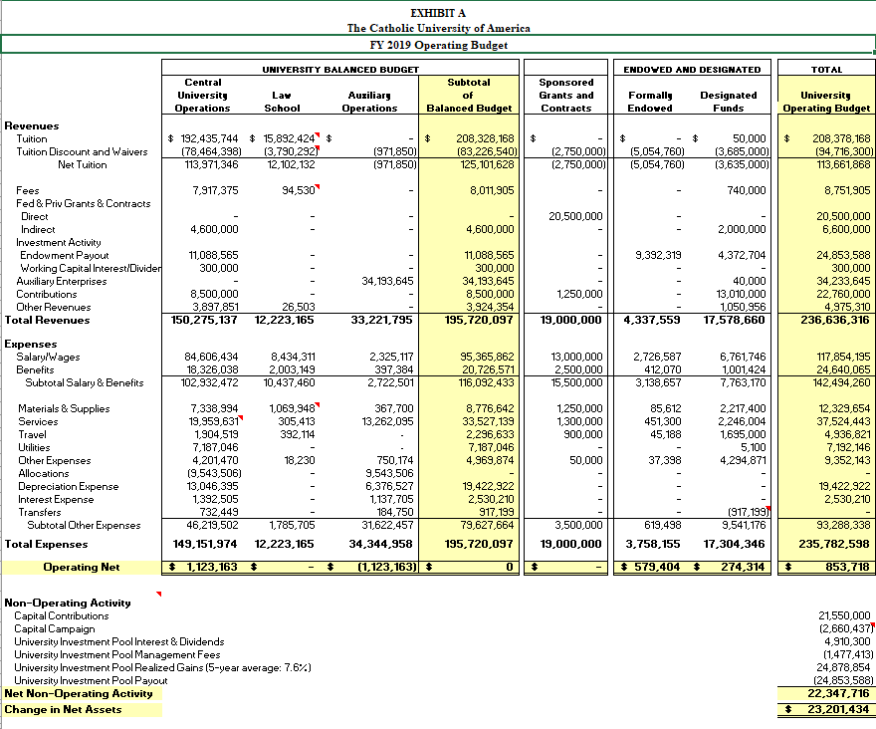
Our Overarching Goal: Keep CUA from Spending More $ During the FY than it is Bringing In
Balanced

Slide 6
What We do NOT do
Final set up new orgs or accounts, or change their attributes (names, managers, etc.) – General Accounting
Make policies regarding compensation or awarding of merit – Human Resources
Establish appropriate & equitable compensation levels – Human Resources
Get involved in any banking transactions including sending wires or calculating endowment payouts – Treasury
Make award decisions about scholarships or waivers – Graduate School/Enrollment Management
Decide what capital projects get done in a fiscal year – Facilities/ VP of cognizant division
Give access to users in Cardinal Station, Student or Financials – Tech Services
Decide appropriate use of donor funds – Advancement/gift agreements
Hold back approved budgets from being loaded/used

Slide 7
What We Really Don’t Do!
Make micro-level decisions about how resources are allocated within Divisions - VPs
John Garvey, President
Larry Morris, Chief of Staff
Robert Specter, VP Finance & Treasurer
Chris Lydon, VP Enrollment Mgmt
Mike Allen, VP Student Affairs
Andrew Abela, Provost
Campus Ministry
Public Safety
University Relations
Academic Schools & Programs
Facilities
Tech Services
Budget & Inst’l Research
Controller
Human Resources
Admissions
Financial Aid
Scott Rembold, VP Advancement
Alumni Affairs
Development
Campus Programs
Athletics & Fitness Center
Dean of Students
Auxiliary Services
Procurement
Public Affairs
General Counsel
Sponsored Programs
Centers & Research
CUA Press
Library
Enrollment Services
Counseling & Health Services
Academic Budget Office

Slide 8
Goals of the Budget Users’ Group
By the next Budget Users’ Group meeting, everyone in the room should:
Know what orgs you are responsible for
Have Cardinal Financials Access
By the end of the fall semester, everyone in the room should:
Know how to run and read nVision reports
Know who to contact with questions or problems
Be doing all of above at least on a monthly basis
CUA
Division
Org/DeptId
School/Unit
Department
Central Admin
VP/Exec Asst, ABO
Dean/AVP
Chair/Admin/Director
PI/Manager

Slide 9
Officially Budgeted Funds
Operating & Auxiliary
Designated
Fund 11 & 15
Tuition, Fee & Sales Revenue
REVENUE budget is set centrally based on Enrollment Projections
No 1:1 relationship between REVENUE budget & EXPENSE budget on an org level that would drive ability to spend
Fund 18, 19, 59
Donor Gifts & Savings from prior FY Operating activity
REVENUE budget is set centrally based on historical actuals & trends
Each Division is given an EXPENSE budget pool (spend authority) matching the Division’s REVENUE budget that can be allocated out as EXPENSE budgets between individual orgs
Even if an org has spend authority through an approved EXPENSE budget, REVENUE must also exist either as new cash already received or as a carryforward cash balance

Slide 10
Other Funds
Endowments
Agency
Fund 31 & 51
Donor Gifts that are invested.
Earn interest quarterly after 1 year of investment.
Only interest may be spent.
Certain donors mandate that unspent interest must be reinvested at fiscal year end & do not roll over.
The annual payout (interest) serves the function of a budget & caps spending, creating a budget error for REQs, payroll, etc.
Additional spending from carryforward can only be done with Budget Office approval.
If cash overspend occurs, it must be replenished from next year’s payout
Fund 47
Not budgeted.
Serves as a pass-through for non-CUA money.
Funders are usually billed by Treasury for actual expenses incurred.

Slide 11
Cardinal Financials Reporting*
“nVision” Reports
Basic YTD Budget: 1ORG, 1DESIG, 1ENDOWED, 1AUX, 1PROJECT,1GRANT
Projections and Estimates: BUDPBB/BUDZERO, BUDMEMO4
Queries
* See handout

Slide 12
Role of University Budget Office Re: iCIMS
Requisitions
Review chart fields for accuracy
Review data completeness including end-dates for “soft funds”
Review requested budget against available amount
Approve or Deny with Note for what is lacking
Offers
Review offer amount against approved requested amount

Slide 13
Frequently Asked Questions/Common Issues
If my department gets more revenue into a fund 11 deptid than expected, can we spend proportionally more in expenses?
No.
Depends on what the money is for, where CUA is in terms of budgets vs actuals, etc.

Slide 14
Frequently Asked Questions/Common Issues Continued
If an expense best fits into a certain deptid, but there is no budget in that org, can I still charge it there?
No.
A budget (and if it is a designated/endowed fund cash) must exist before any charges can be made.
PBR, funds transfer

Slide 15
Future Session Topics
FY19 Fiscal Management
Running & Reading Reports
Operating Fund nVisions
Designated Fund nVisions
Endowed Fund nVisions
Other Useful Reports & Tools
Other Processes
REQ overrides
Budget Revisions
Funds Transfers
Filling out Forms
Your Role & Responsibilities
FY20 Budget Planning
Calendar & Deadlines
Operating Fund Templates
BUDZERO/BUDPBB for individual fund 11 & 15 orgs
BUDSMRY for compiling division
Designated Fund Templates
BUDMEMO4 for individual fund 18, 19 & 59 orgs
BUDSMRES for compiling division

